Slide 1


Slide 2
EZ-Data
Project - A Comprehensive Review of Student Data Management System

Slide 3



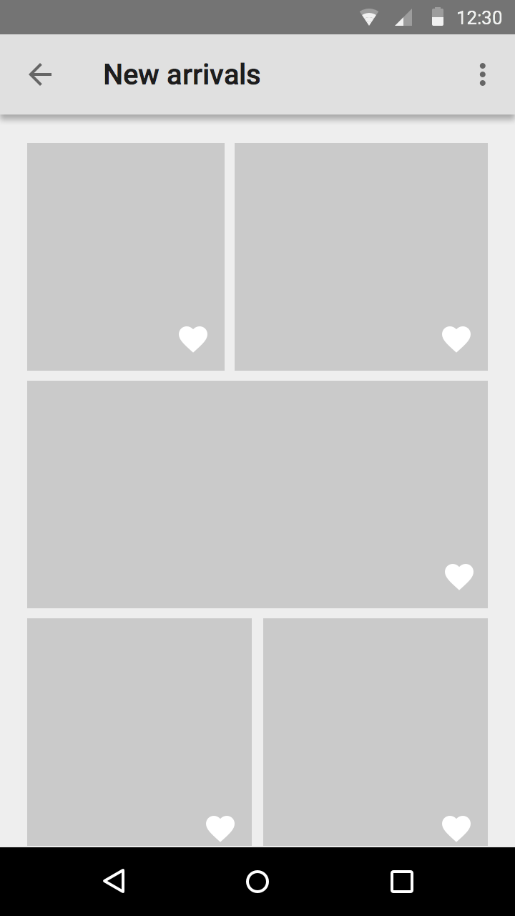
Overview

Slide 4
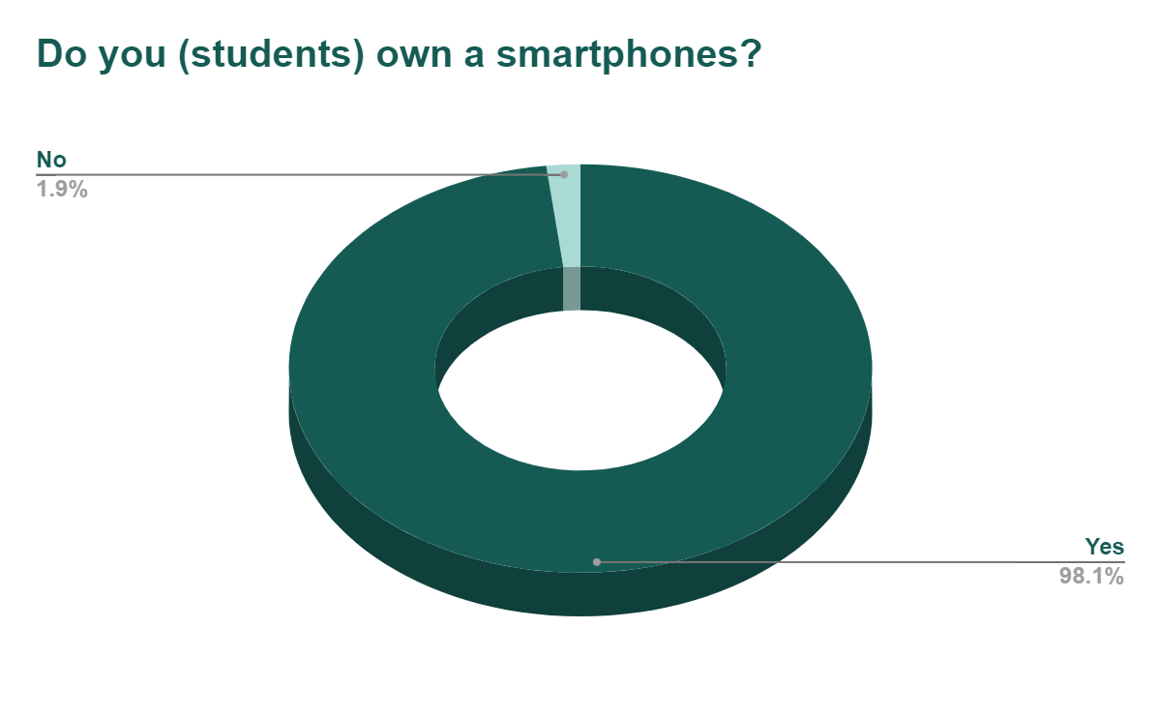
SAMPLING
No
(1.9%)
The data shown here refers to the actual survey done amongst the students of Electrical And Electronics Department.
Yes
(98.1%)

Slide 5
Problem Statement
No common platform available to track bits information like attendance , marks etc

Slide 6
Approach
New user-friendly Application
Easy Access to Teacher, Student
Cross-platform based Application
(Android , IOS etc.)

Slide 7

Working
Student login
Teacher login

Slide 8

Teacher Login
Upload ppts
View
Attendance
Edit
Analytics
Subject
View
Marks
Edit
Schedule Quiz

Slide 9

Student login
View attendance
Subject 1
View marks
Analytics
Student ID
View attendance
Subject 2
View marks
Quiz notifications
Access ppts and post queries

Slide 10
Analytics
Attendance
Student score
Class average
Marks

Slide 11
Additional Information
Administrator:- Person can perform CRUD (create, read, update & delete) operations on the database
Downloading & Exporting of reports
The Application supports both IOS and Android
The Application is easy to install and use
Online Proctoring and Broadcasting of Information can be done

Slide 12






Slide 13
Conclusion
The idea for this project came up because of the complications faced by:-
Teachers while updating and reviewing the student report (marks and attendance)
No scope for periodic performance monitoring for Students
No common platform for Teachers and Students to discuss on a regular basis
By developing this application we aim to simplify the complications mentioned above, reduce workload for teachers and provide an Efficient & Effective solution.

Slide 14
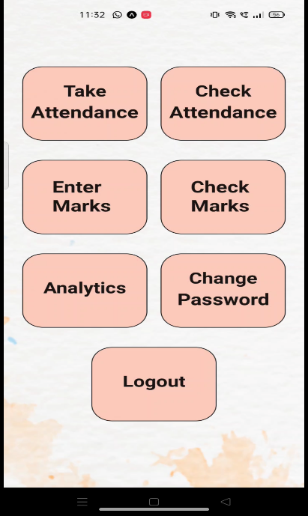

Mockups
Teacher
Login

Slide 15
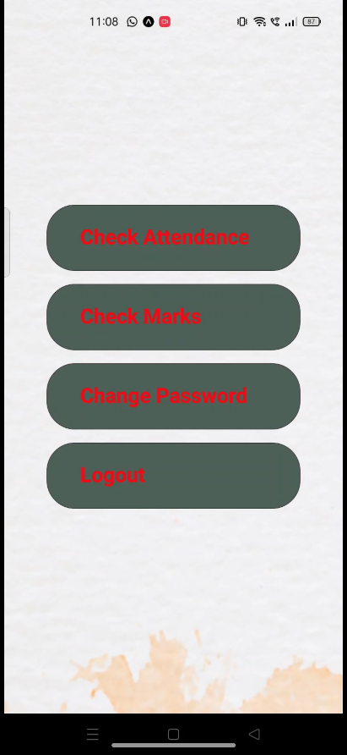
Student
Login

Slide 16


Thank you!

Slide 17
Q & A

